Slide 1


Effective Presentation Skills
April 2014
This document is confidential and contains proprietary information, including trade secrets of CitiusTech. Neither the document nor any of the information contained in it may be reproduced or disclosed to any unauthorized person under any circumstances without the express written permission of CitiusTech.

Slide 2
Content
Objective Behind Presentation
Understand Your Audience
Important Ingredients Of Effective Presentation
Key Elements Of Effective Presentation
Planning & Structuring Your Presentation
Introduction, body & conclusion
Dealing With Nervousness

Slide 3
Objective Behind Presentation
Purpose behind presentation – Why is it important?
What you want to achieve/communication goals?
– Persuade?
– Inform and educate?
– Inspire them to think about your topic?
What do you want your audience to understand?
It helps decide your overall approach while presenting the topic
For example, a presentation to a seminar group might require a balanced argument, whereas a charity appeal might require a more creative approach
How does these communication goals are linked with larger goals of your audience

Slide 4
Understand Your Audience
Who are they? What is their background? Level of understanding? Interest in the topic?
– Different ways to know your audience
This would help you to – ‘Think in terms of your audience’
– Consider the points they want to hear.
– Identify details they are likely to challenge.
– Be aware of aspects that may upset them.
– Anticipate the questions they are likely to ask.
– Give relevant examples
– PLAN FOR EACH OF THESE
If you fail to consider your audience’s needs, you will fail to appeal to their interest and imagination.
Notes:
Look for broad commonalities
Ensure that you have targeted your material at the right level for their needs.
This might involve avoiding technical jargon or explaining abstract concepts with clear practical examples.
What background knowledge do they have about your topic?
How are you going to involve them in your presentation?
How much will your audience already know about your topic?
How can you link new material to things they might already understand?

Slide 5
Understand Your Audience - Example
Event: An event coordinator for restaurant association asked presenter to deliver session on ‘social media’ at annual conference.
Presenter: “Tell me everything about the audience.”

Slide 6
Key Elements Of Effective Presentation (1/4)
Talk to your audience, don't read to them!
– Include everyone by looking at them and maintaining eye-contact
Use the Rule of 3: (logical flow)
– Tell them what you are going to tell them
– Tell them
– Tell them what you told them
Watch your language!
– Keep it simple. The aim is to communicate, not to show off your vocabulary.
– Emphasise the key points—and make sure people realise which are the key points. Repeat them using different phrasing.
– Check the pronunciation of difficult, unusual, or foreign words beforehand.
Notes:
(but don't stare or glare at people).

Slide 7
Key Elements Of Effective Presentation (2/4)
Use your voice to communicate clearly
– Speak loudly enough for everyone in the room to hear you. Don’t Shout.
– Speak slowly and clearly.
– Don’t rush! Speaking fast doesn’t make you seem smarter, it will only make it harder for other people to understand you.
– Key words are important. Speak them out slowly and loudly.
– Vary your voice quality. If you always use the same volume and pitch (for example, all loud, or all soft, or in a monotone) your audience will switch off.
– When you begin a new point, use a higher pitch and volume.
– Slow down for key points.
– Use pauses—don't be afraid of short periods of silence. (They give you a chance to gather your thoughts, and your audience a chance to think.)

Slide 8
Key Elements Of Effective Presentation (3/4)
Interact with the audience
– Be aware of how your audience is reacting.
– Are they interested or bored? If they look confused, ask them why
– Stop if necessary and explain a point again.
Check if the audience is still with you.
– ‘Is that clear?’
Be open to questions
– If someone raises a hand, or asks a question in the middle of your talk, answer it.
– If you can't answer it, turn the question back out to the audience and let someone else answer it!
– Questions are good. They show that the audience is listening with interest.
– They should not be regarded as an attack on you, but as a collaborative search for deeper understanding.

Slide 9
Key Elements Of Effective Presentation (4/4)
Use your body to communicate, too!
– Stand straight and comfortably. Do not slouch or shuffle about. Do not stand in front of your slides
– Hold your head up. Look around and make eye-contact with people in the audience.
– Do not stare at a point on the carpet or the wall. If you don't include the audience, they won't listen to you.
– When you are talking to your friends, you naturally use your hands, your facial expression, and your body to add to your communication. Do it in your presentation as well. It will make things far more interesting for the audience.
– Don't turn your back on the audience!
– Note: When your audience stops looking, they’ve stopped listening

Slide 10
Planning & Structuring Your Presentation
You need to plan the structure of your presentation very carefully. Consider:
– The time limit
– The amount of information available, then determine how much of it you will cover
– How much detail you can include
Have a clear, organised structure for your presentation.
It requires an introduction, body and conclusion.
– An introduction is like a roadmap that tells your audience the direction your presentation will take.
– The body of presentation is where you develop the main points and present examples and evidence.
– The conclusion is usually a summary of the main points made in the body of the talk.

Slide 11
Introduction
Use your introduction to lay a clear foundation for the presentation to follow.
Capture your listeners’ attention
– Begin with a question, a funny story, a startling comment, or anything that will make them think.
State your purpose
– for example: ‘I’m going to talk about...’ ‘This morning I want to explain…’
Present an outline of your talk
– for example: ‘I will concentrate on the following points: First of all…Then… This will lead to… And finally…’

Slide 12
The Body
Present your main points one by one in logical order.
Pause at the end of each point
Make it absolutely clear when you move to another point. For example:
– ‘The next point is that ...’ , ‘OK, now I am going to talk about ...’
Use clear examples to illustrate your points.
Don’t be repetitive. Make sure you don’t drag your point too long.
The supporting information helps your audience understand, believe in and agree with your main points.
– This evidence might take the form of factual data, points of detail or an explanation of process.
– It might be presented in imaginative ways using diagrams, pictures or video segments.
Notes:
what will add clarity to your argument (explaining complex terms, reminding your audience of any supporting theories)?
what will add authority to your argument (making connections with other people's work, quoting experts, offering evidence from your own research)?
what will add colour to your argument (showing a video clip or a slide, using a practical example or a vibrant analogy)?

Slide 13
The Conclusion
It is very important to leave your audience with a clear summary of everything you have covered.
It is also important not to let the talk just fizzle out. Make it obvious that you have reached the end of the presentation.
Summarise the main points again, using phrases like:
– ‘To sum up...’ – ‘So, in conclusion...’ – ‘OK, to recap the main points…’
Restate the purpose of your talk, and say that you have achieved your aim:
– ‘I think you can now see that...’ – ‘My intention was ..., and it should now be clear that ...’
Thank the audience, and invite questions:
– ‘Thank you. Are there any questions?’

Slide 14
Dealing With Nervousness!
The first few times you make a presentation, you will be nervous. Its ok.
Be well-prepared. Rehearse/practice giving your talk in front of mirror or friend
Revisit the flow in your mind
Revise the main points that should get convey
Don’t by heart your presentation/points
As you start delivering you will feel less nervous, and will able to control your nervousness.

Slide 15
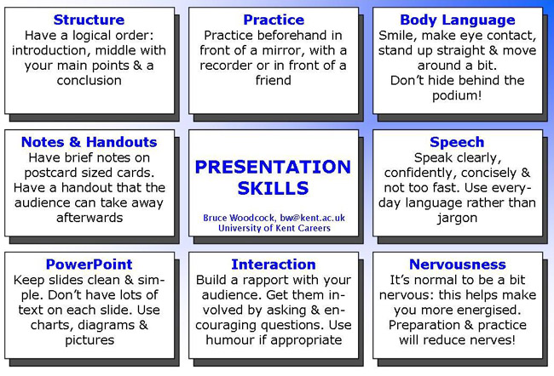
Summary: Important Ingredients Of Effective Presentation

Slide 16
Key Elements Of Effective Presentation
Activity: List key points that you feel are important for effective presentation

Slide 17
Activity: Presentation Topics
Importance of emotional intelligence
Stress management
Importance of having an aim in your life
Drawbacks of democracy
Influence of media on your life
Work from home

